Slide 1
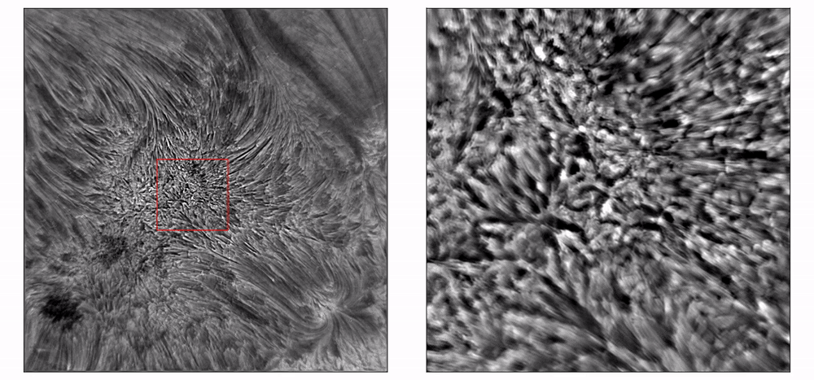


ESCUELA DE ASTROFÍSICA SOLAR · OCTUBRE 2026
HelioData
Academy 2026
Magnetohydrodynamics and solar oscillations
Óscar Andrés Calvo Rebellón· Observatorio astronómico nacional · 15/oct/2026
Group of Solar Astrophysics GoSA
Observatorio Astronómico Nacional · UNAL Bogotá

Slide 2
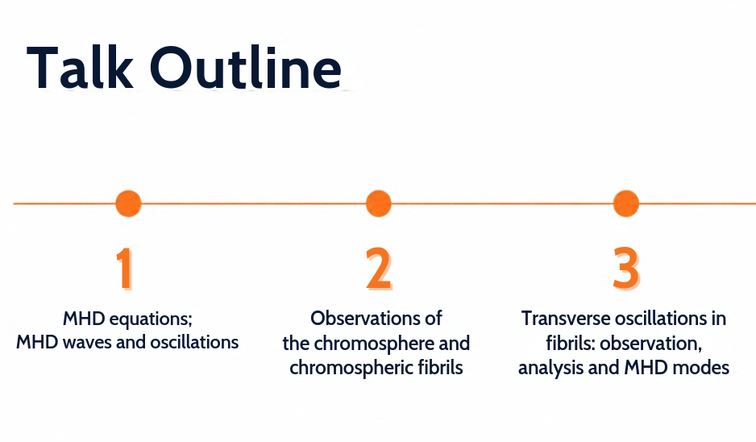
HELIODATA ACADEMY 2026 · ESCUELA DE ASTROFÍSICA SOLAR

Slide 3
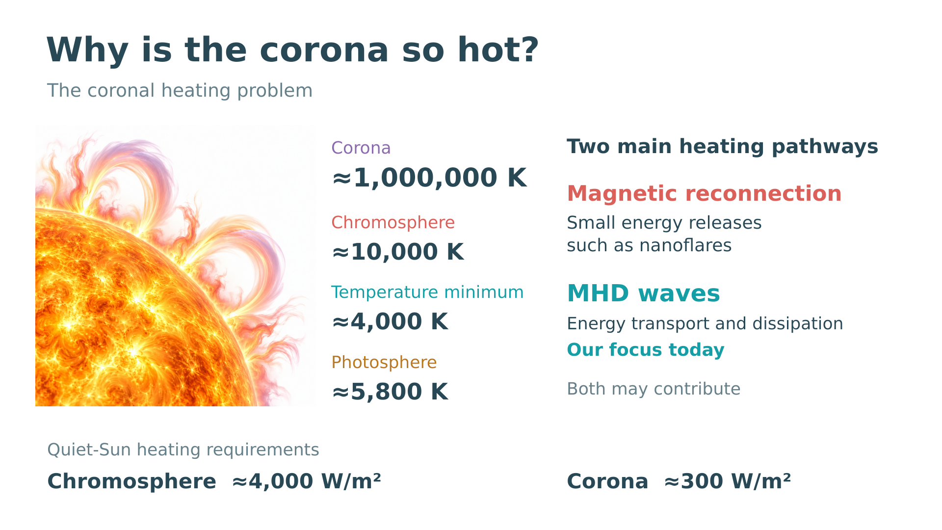

Slide 4
Section
01
MHD equations and waves
What happens when you shake a magnetic field?
3
HELIODATA ACADEMY 2026 · ESCUELA DE ASTROFÍSICA SOLAR

Slide 5
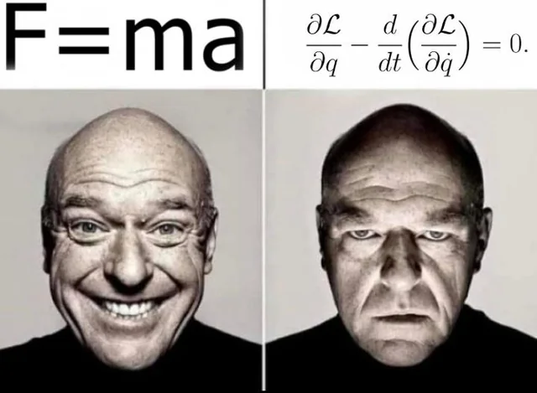
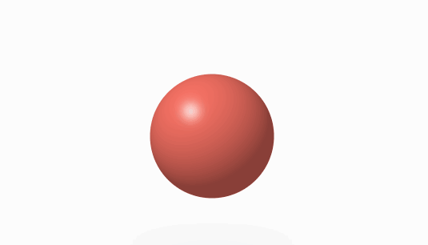
Newton's second law … again!

Slide 6

Newton's second law … In a fluid

Slide 7
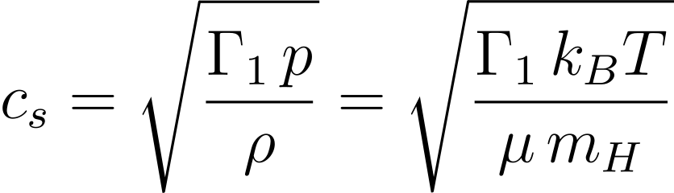
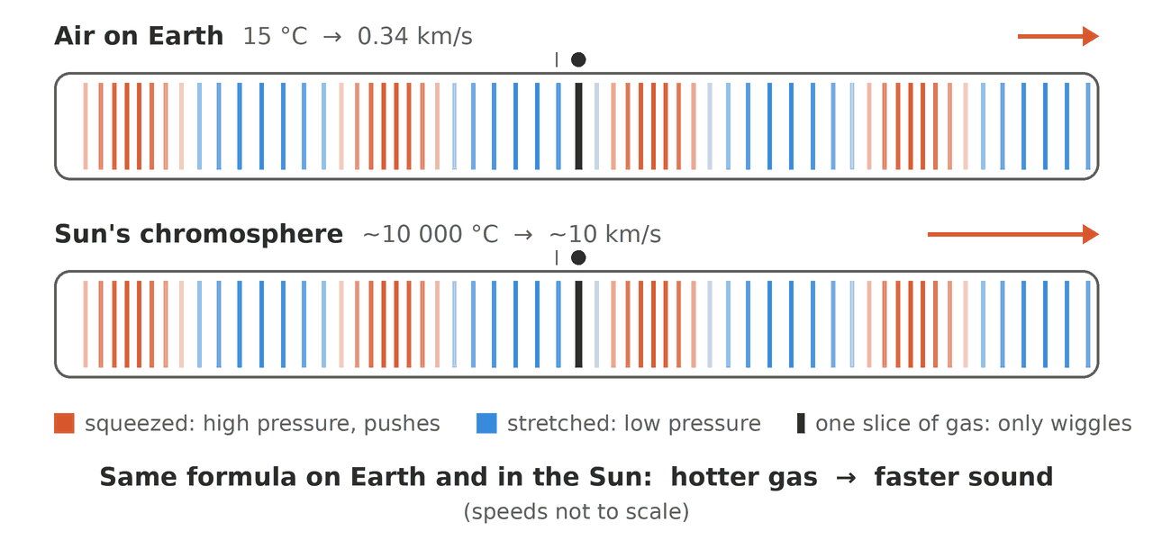
The first wave: sound

Slide 8
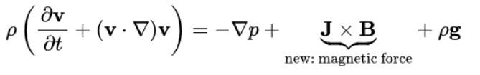
Newton's second law … In a plasma

Slide 9
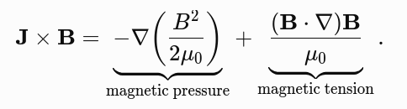
The missing ingredient: the magnetic field

Slide 10
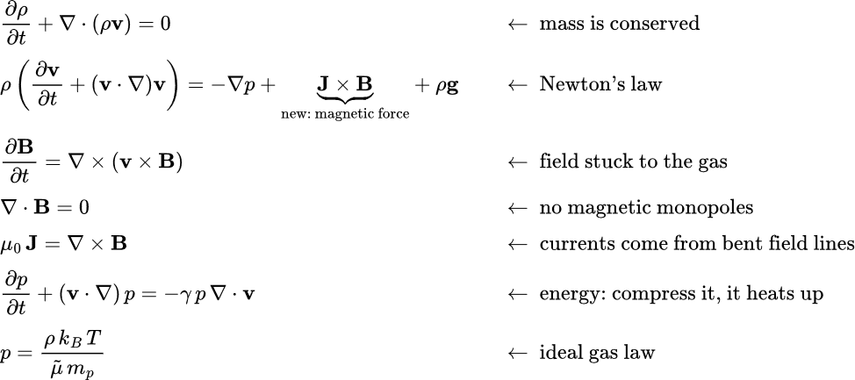
MHD’s equations

Slide 11
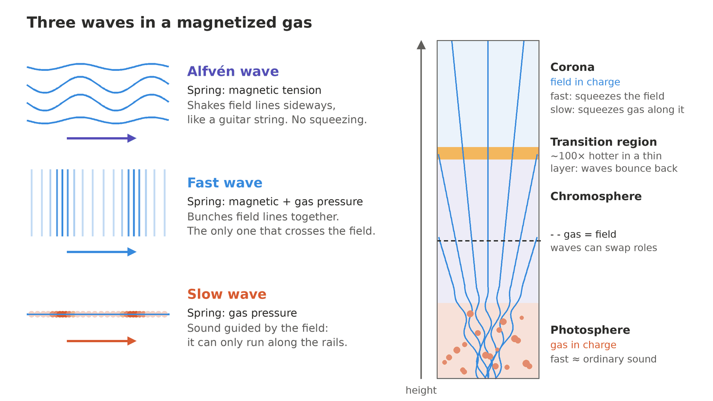
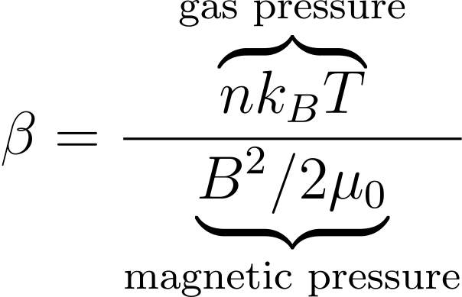
Three waves in a plasma

Slide 12
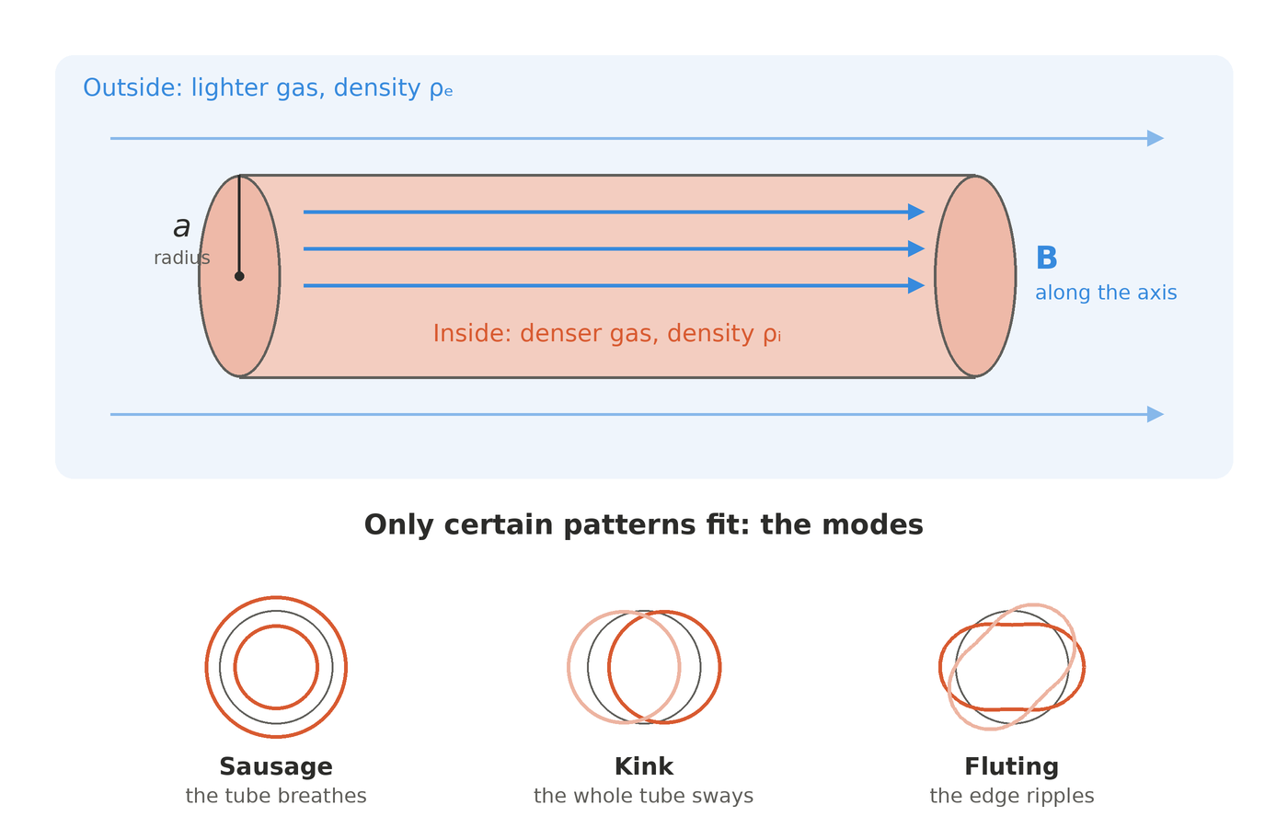
From waves to modes: the tube is a waveguide

Slide 13
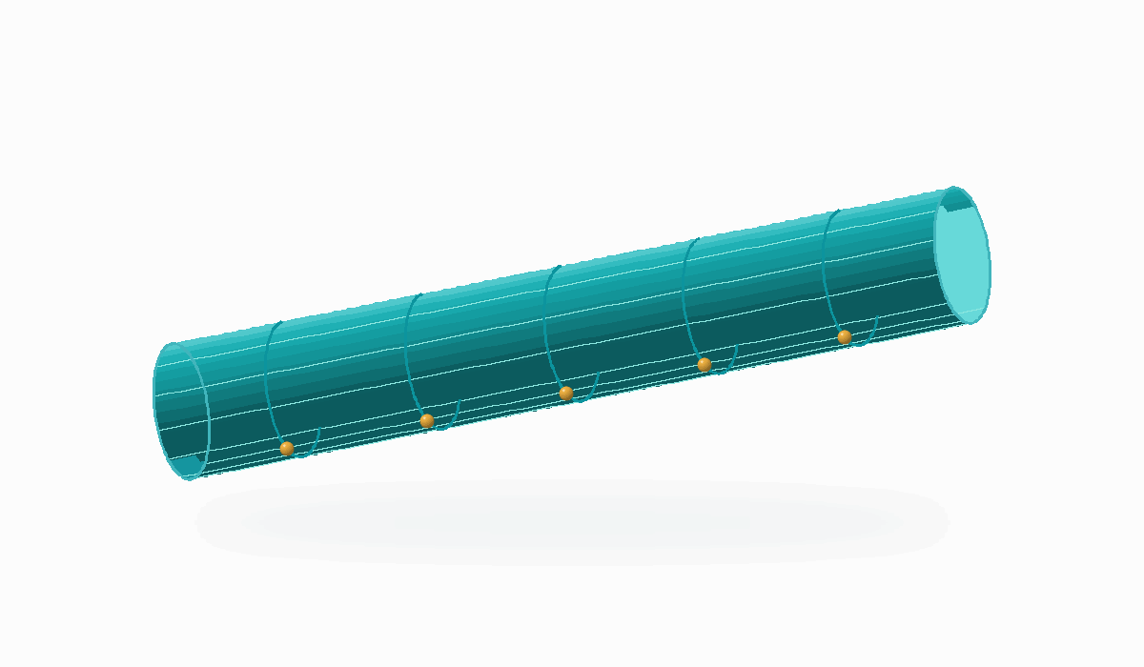
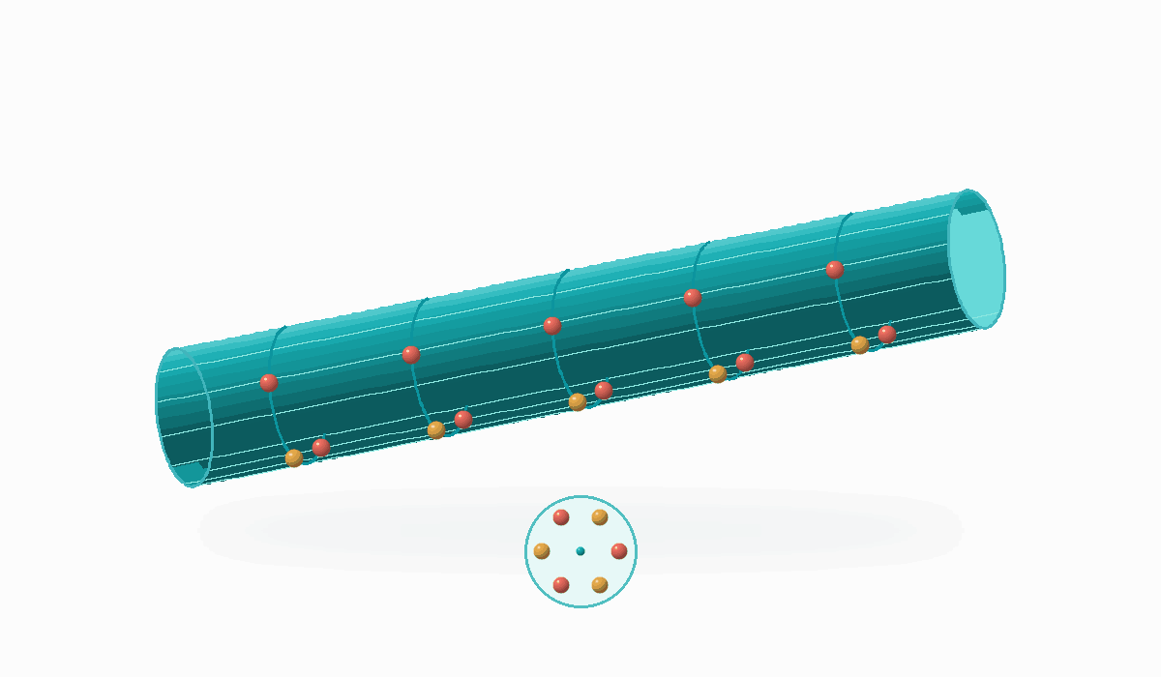

From waves to modes: the tube is a waveguide
Kink
Sausage
Torsional Alfvén

Slide 14
Section
02
Observations :)
How do we see waves on the Sun?
3
HELIODATA ACADEMY 2026 · ESCUELA DE ASTROFÍSICA SOLAR

Slide 15
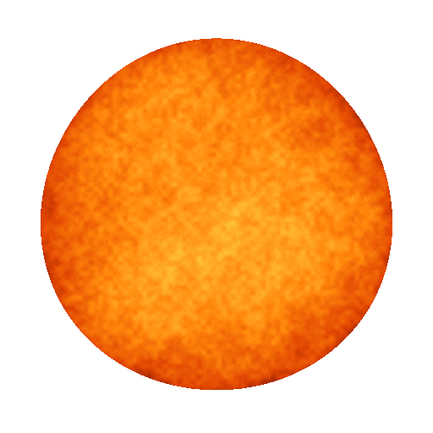
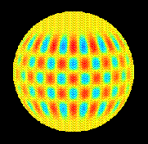
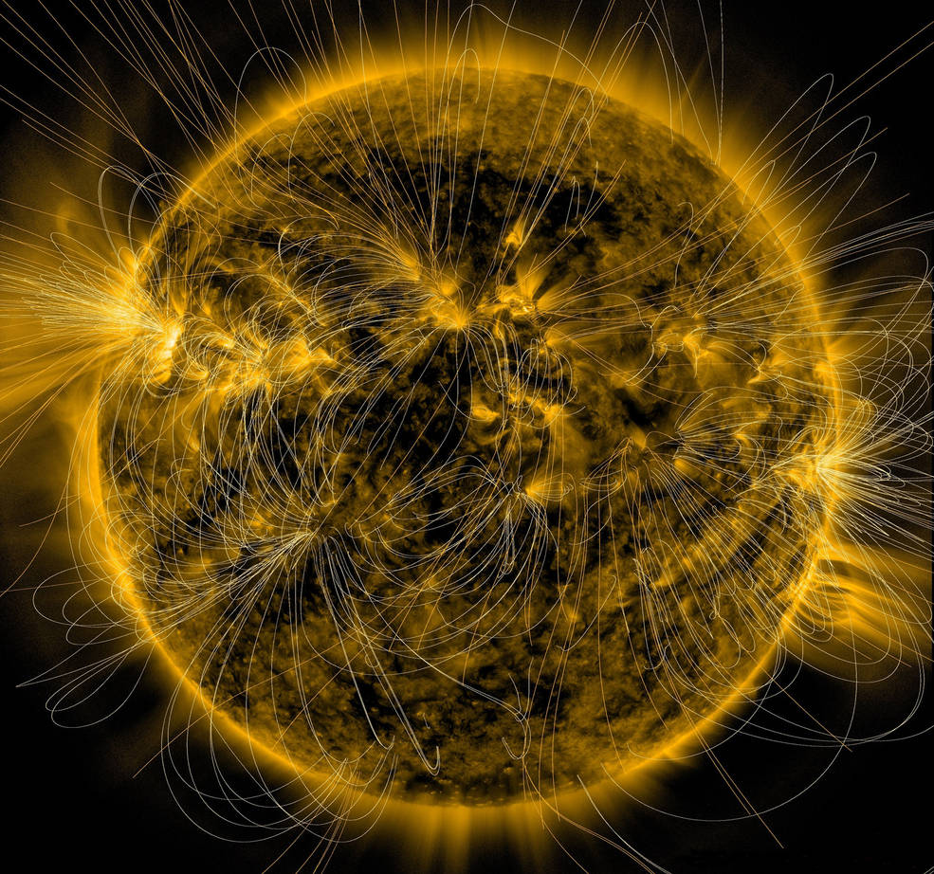
The sun vibrates everywhere

Slide 16
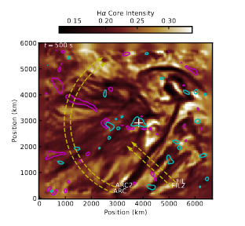
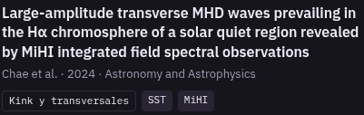
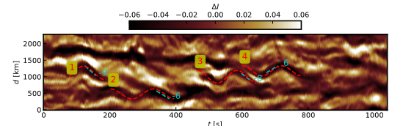

Slide 17
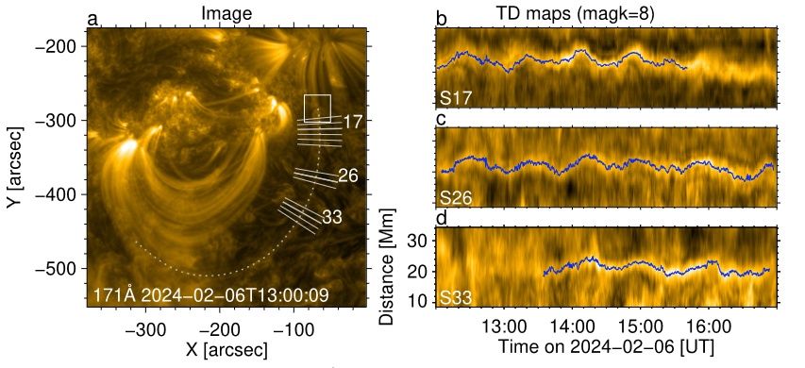
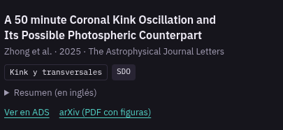

Slide 18
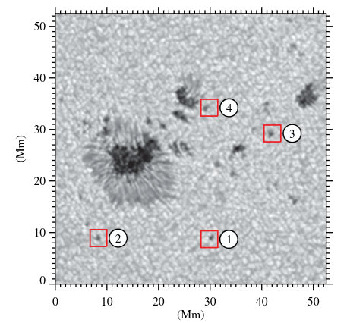
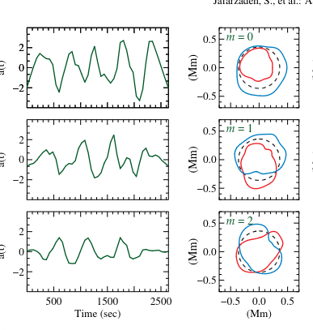
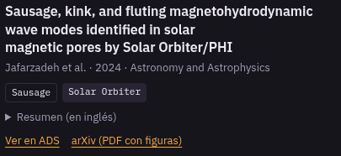
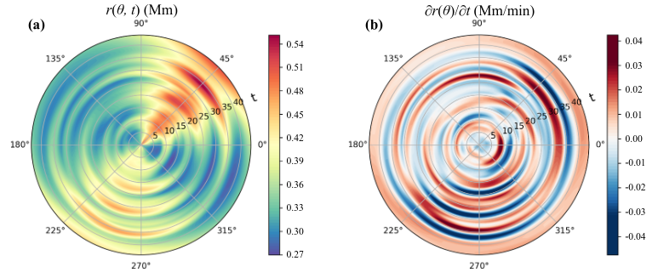

Slide 19
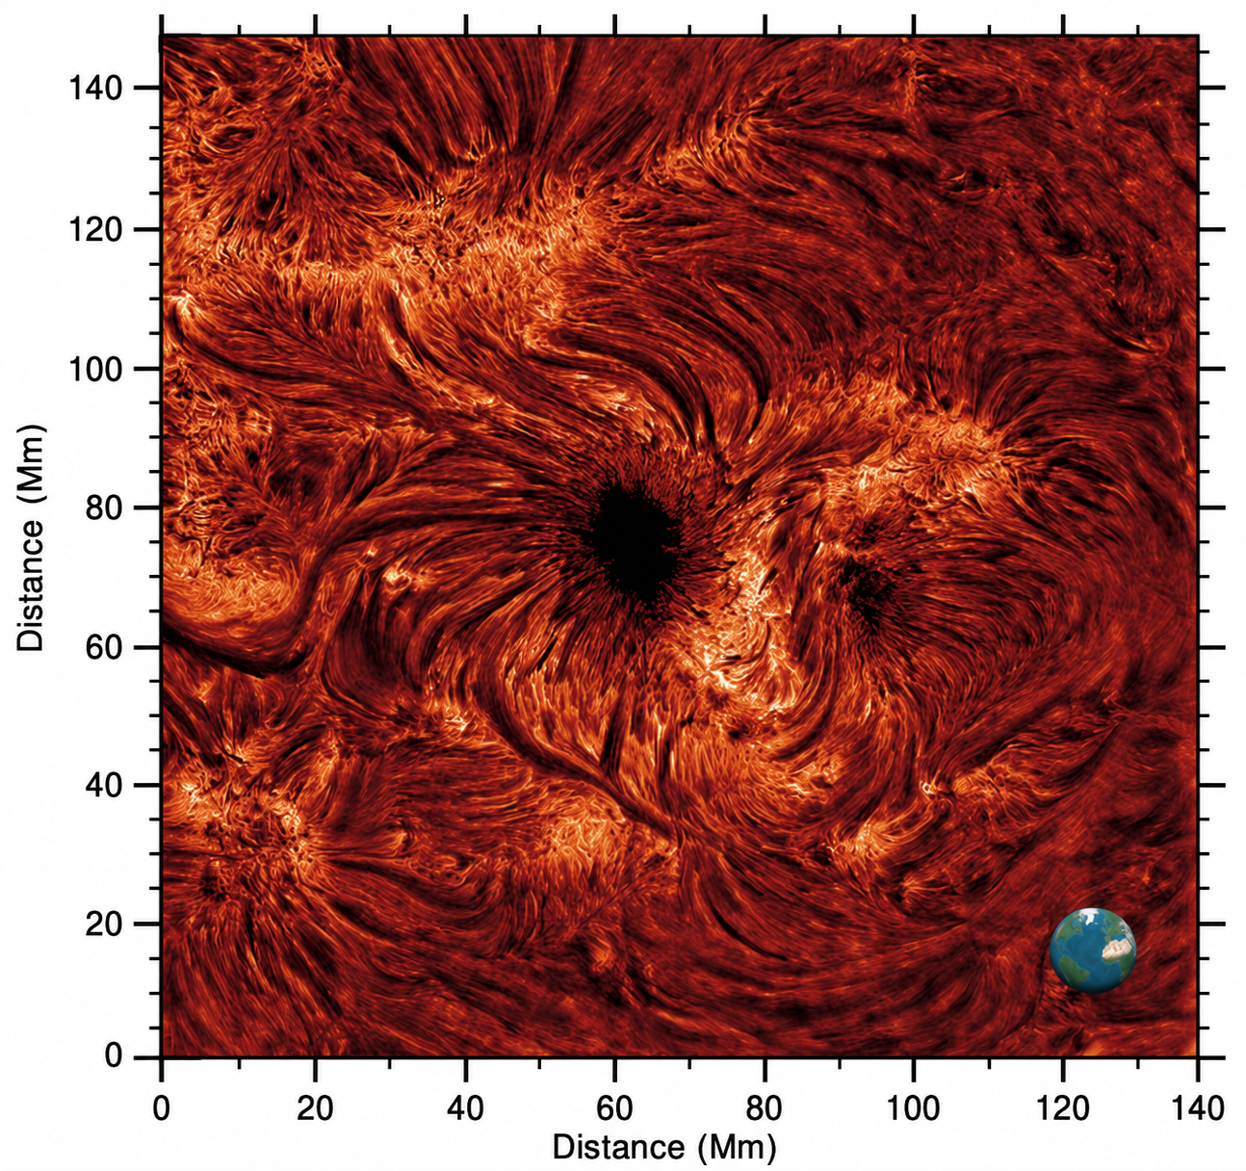
How the chromosphere is observed
The chromosphere is a dynamic layer of the solar atmosphere located above the photosphere and below the transition region.

Slide 20
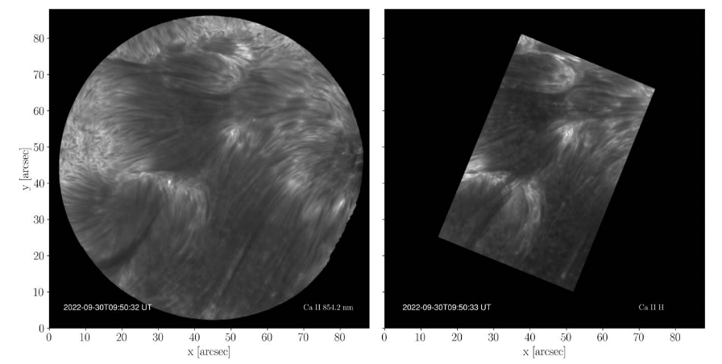
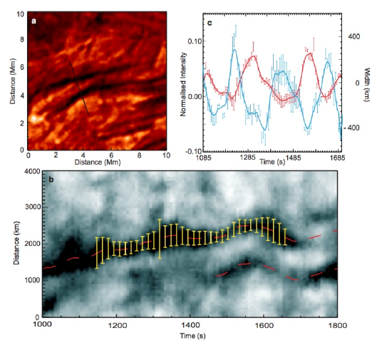
Fibrils
Image taken from Kriginsky and Oliver (2025).

Slide 21
Section
03
TRANSVERSE OSCILLATIONS IN FIBRILS: OBSERVATION, ANALYSIS AND MHD MODES
3
HELIODATA ACADEMY 2026 · ESCUELA DE ASTROFÍSICA SOLAR

Slide 22
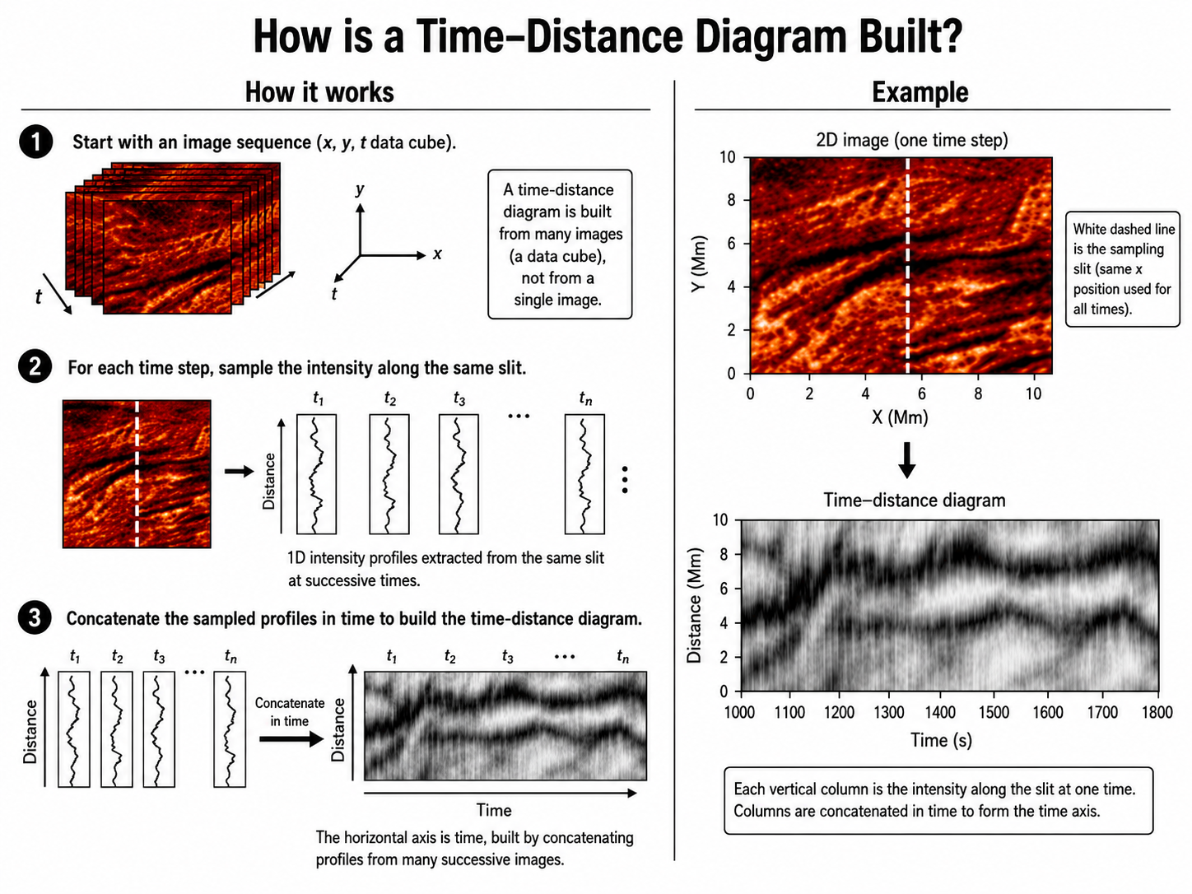

Slide 26
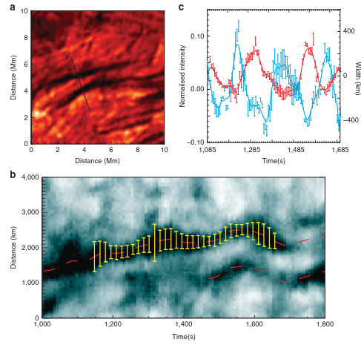
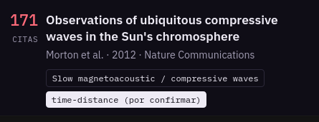

Slide 27
CODES :))))

Slide 28
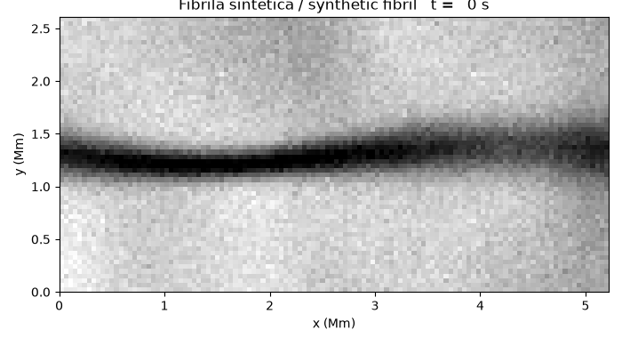

Slide 29
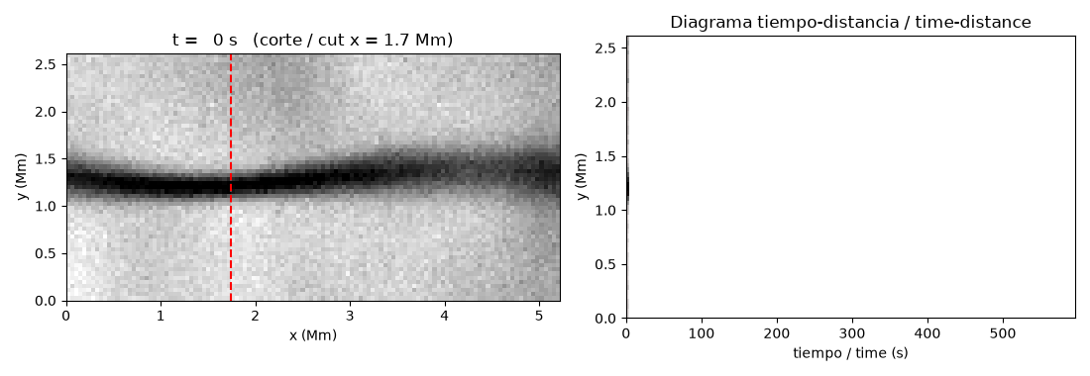

Slide 30
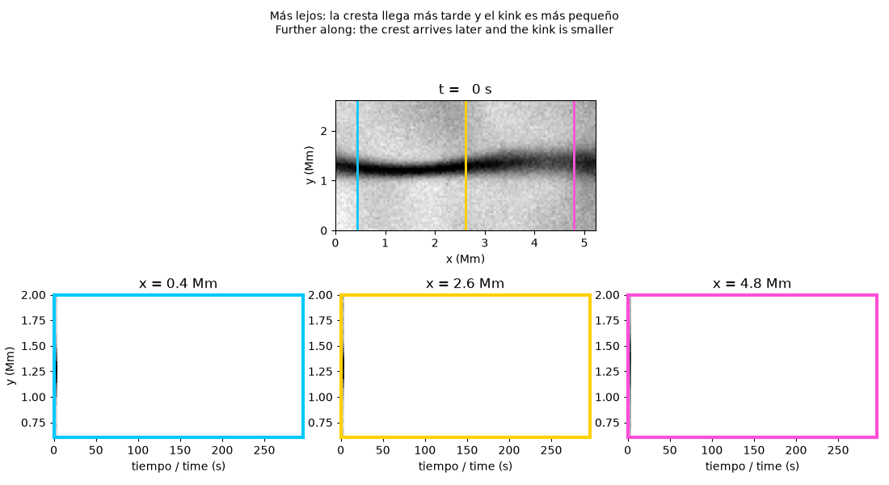

Slide 31
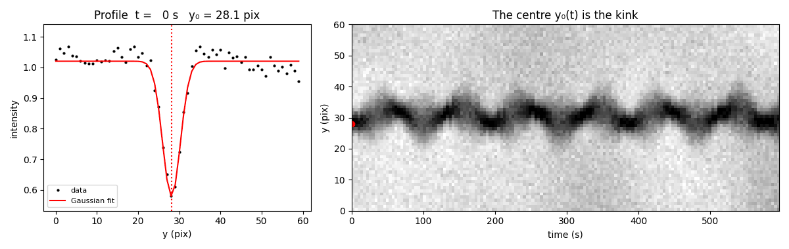

Slide 32
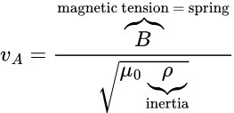
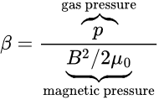

Slide 33
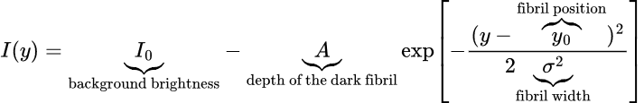

Slide 34
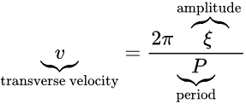
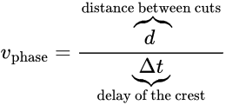

Slide 35
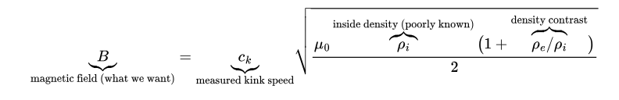

Slide 36


Slide 42
Conclusiones
LO QUE NOS LLEVAMOS HOY
1. [Conclusión principal]
2. [Segunda idea importante]
3. [Cómo se conecta con lo que sigue]
PRÓXIMA SESIÓN › [tema, tarea o lectura recomendada]
9
HELIODATA ACADEMY 2026 · ESCUELA DE ASTROFÍSICA SOLAR

Slide 43
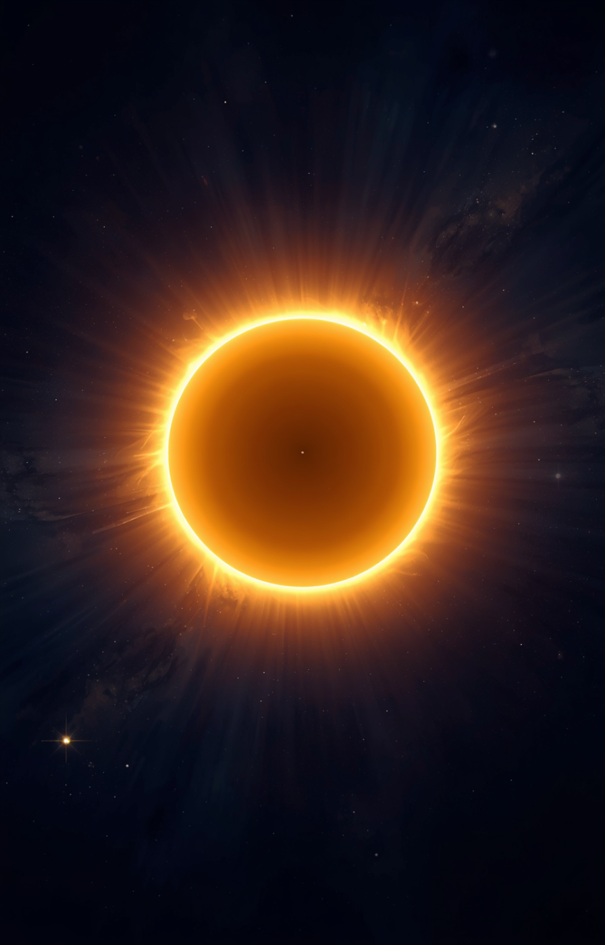
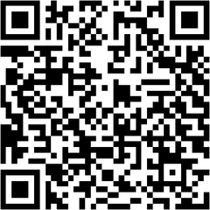
¡Thanks a lot!
Questions?
Óscar Calvo
ocalvo@unal.edu.co]
Registro
tiny.cc/escuelasolar
Más información
astronomiaoan.co/gosa/escuela.html
Organiza: Group of Solar Astrophysics GoSA
Observatorio Astronómico Nacional · UNAL Bogotá

